Slide 1

Children’s Camp Meeting 2025
Wyoming County Environmental Health Department
5362A Mungers Mill Road
Silver Springs NY, 14550
585-786-8894

Slide 2
Introductions:
Rob Jines- Director of Environmental Health
Shelley Connelly – Senior Account Clerk
Andy Meyer – Public Health Program Coordinator/Deputy Director of Environmental Health
Rick Stevens – Public Health Sanitarian
Ryan Hamilton – Public Health Technician
David Parfitt - Public Health Technician
Erik Von Sanden – Public Health Technician
Chris Eddy - Public Health Technician
Nate Hall – Environmental Health Field Coordinator NYSDOH

Slide 3
Day Camps:
Operate between June 1 – September 15
For children 16 years old and younger.
Operating more than 5 days in a two week period.
Operates less than 24 hours in any day.
Two or more activities.
Campers do not typically stay overnight.

Slide 4
Overnight Camp
For campers under 18 years old.
Occupied for greater than 72 consecutive hours.
Includes indoor and outdoor activities.
Provisions made for overnight occupancy.
Notes:
Keep this in mind if your camp facility is renting out the facility to outside groups, you can see if they qualify as a children’s camp or not. If they do or may qualify please pass them along to me.

Slide 5
Form Submission
Application DOH 3965 including Workers Comp and Disability
Facility and Staff Description DOH 367 and DOH 367(a)
Director Certified Statement DOH 2271
State Central Register Database Check LDSS 3370
Safety Plan Template with appendices for activities
Water startup certification
All Forms Due Min. 60 Days prior to Camp
If sending forms Electronically (email) send to Shelley Connelly: sconnelly@wyomingcountyny.gov
Please copy on all emails rstevens@wyomingcountyny.gov

Slide 6
Safety Plans
Use Safety Plan Guide (PDF).
Review existing plan, inconsistencies, outdated material, add new activities.
Each camp needs their own specific safety plan.
Add Template addendums where appropriate. Guide and Templates available on NYSDOH website.
Inspections will check for consistency with your operating procedures.

Slide 7
Communication of Safety Plan
It is highly recommended to review your safety plan and appendices with your staff.
Health Director
Aquatics Director
Activity Staff
Any changes made need to be reflected in the safety plan.

Slide 8
Child Safety Act
Sex offender registry checks on employees / volunteers must be completed before camp.
30 or more individuals is to be submitted by e-mail, no Faxing.
When filling out spreadsheet pay careful attention to the headings noted on fact sheet.
Less than 30 individuals can be submitted by Fax or mail.
A copy of the DCJS response must be on site at start of camp.
Notes:
If you have any questions on this please let me know.

Slide 9
New York State Department of Health Requirements for Campers with Disabilities at Children’s Camps
Applies to ALL camps enrolling one or more campers with a physical or developmental disability.
Camp must have a mechanism for identifying campers with a disability. Question on Application?
Supervision Ratio 1:2, 1:1 Swimming 1:5, 1:1
Treatment / behavioral plans on file at camp.
Camp must provide training to staff directly responsible for the care of campers with developmental and/or physical disabilities. This training must be documented.
Additional swimming requirements must be implemented, such as parental written permission and increased supervision ratios.
Notes:
How are we identifying campers with developmental disabilities?
Camp needs to develop training for staff who are directly responsible for the care of campers with developmental or physical disabilities and must document the training

Slide 10
New York state PROTECTION OF PEOPLE WITH SPECIAL NEEDS ACT
The amendments apply to Children’s Camps with 20% or more campers that have a developmental disability.
Camp staff are required to obtain mandated reporter training.
Notes:
if your camp qualifies please let me know and we will work thru the process.

Slide 11
Statewide Central Database Check
Print legibly!
Include a MONTH and year for residency records. Our office cannot fill in the blanks.
Get these forms to our office early.
Multiple submissions? (Director / Assistant Director).
Notes:
Redundancy having multiple people cleared incase something happens to the camp director.

Slide 12

Water Supply
Start up procedures.
Water samples collected minimum 15 days prior to camp. Call to schedule with our office.
Documentation of chlorine testing on the operation report to be done by a responsible person every day.
Operation report submitted to this office by the 10th day of the following month.
Call our office with potential problems.

Slide 13
Water Supply Continued
Sampling – Health Department staff will be stopping in to collect bacteriological samples once a month during camp operation.
Please ensure you have adequate free chlorine residual at all times of operation. Lack of free chlorine will put your camp on a boil water notice.

Slide 14
Inspections Pre-operational and Operational
One pre-operational inspection needed per facility.
The camp is responsible for scheduling the pre-operational inspection with our office. Facility should be ready to operate at time of pre-op inspection.
Operational inspections are unannounced – We need your dates of operation correctly listed on DOH 367.
Important reminder – satisfactory water samples must be taken prior to camp operation.
Notes:
This has not changed, you still need to coordinate with our office on completing a pre op inspection. At this point most everything should be ready to go at camp and water samples should have been collected.
During camp we will be around to check in on your operations.

Slide 15



Camp Operations

Slide 16
Camper Supervision
Methods sited in safety plan.
Ratios met for Day or Overnight Camp appropriate for various age ranges and activities.
Visual or verbal communications capabilities between camper and counselor during activities. A method for accounting for camper’s whereabouts at all times.
Appropriate counselor ages: 18 years old for overnight camps, 16 years old for day camps.
Notes:
Overnight camp 1:10, 1:8 younger than 8. Day camp 1:12

Slide 17
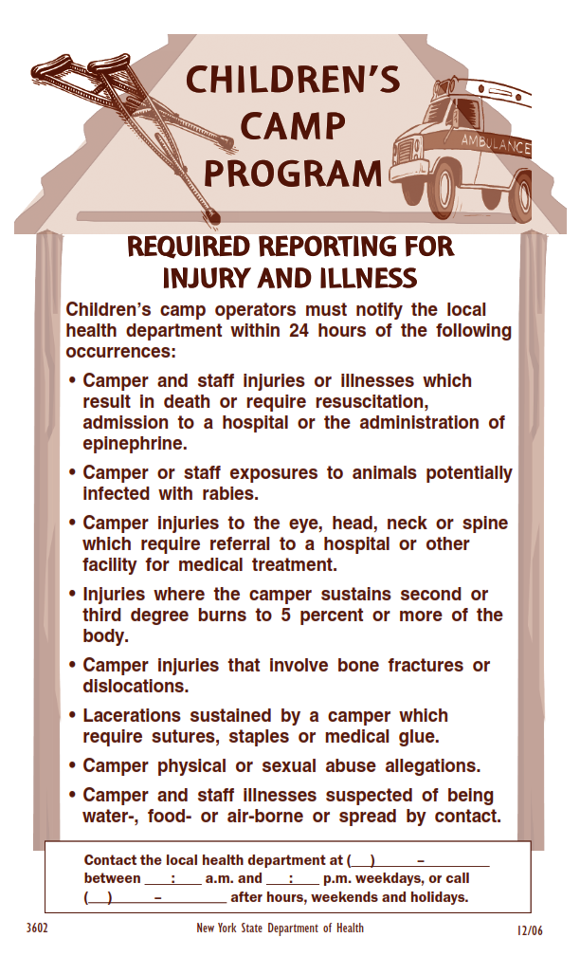
Medical
Staff Qualifications Proper NYS Licensure
Medication Administration
Medication Storage
Pre camp screening/check in
Documentation
Reporting Requirements
Illness Injury Reportable poster
Notes:
Knowing what the qualifications of you medical staff and what their limitations are, must be your responsibility. Review this with your staff and be sure your safety plan reflects this.
If you have multiple levels of medical staff please have safety plan procedures for each level so we know how you are operating under various levels of staffing.
Many of our camps have started a more intense screening including head lice check.

Slide 18
Health Director Qualifications
Physician, nurse practitioner, physician assistant, registered nurse, licensed practical nurse, EMT.
First Aid and CPR certifications.
Overnight Camps must be located on site.
Day Camps- may be located off-site with an on-site designee.
Must be available to respond as specified in the Safety Plan.

Slide 19
Camp Health Director Responsible for
Maintaining Camper’s confidential medical history.
Overseeing initial health screening of campers and daily health surveillance of camp occupants.
Handling health emergencies and injuries.
Maintaining camp’s daily medical log.
Submitting required Incident Reports to the LHD within 24 hours.

Slide 20
How To Contact Our Office
During business hours 585-786-8894
Fax 585-786-8167
After Hours and Weekends.
Call 585-786-2233 (Hospital)
Tell them you have a camp issue for Environmental Health.
Wait for Rob to call you back.
Notes:
Save forms and faxes

Slide 21
Additional Camper Medical Info
Children may carry and use sunscreen / insect repellent if a permission slip from a parent is on file at camp.
Amended PHL to allow children’s camps to access NYSIIS and CIR to obtain vaccination records.
Medication: Asthma inhalers, camper epi pens, and other emergency lifesaving medications prescribed to the camper may be carried by the camper.
Section 3000-c Epi pen auto-injector Amendments Effective March 29, 2017.
Notes:
If consular carries life saving medications, make sure they give it to a new consular is the camper switches groups or consulars go on break, etc.

Slide 22



Potential Rabies Exposures
Bats in camp
Wild animals
Camp “pets” need current rabies vaccination
Reporting exposures
DOH Form
Call us immediately
Notes:
Horseback riding, vaccines should be accessible.

Slide 23

Prevent Bat Exposures
Capture/testing of bats in exposure incidents.
Staff and camper education.
Inspect for roosts and bat presence in sleeping quarters and heavily trafficked day use areas.
Exclude bats from sleeping quarters.
Structural modification
Denial of re-entry

Slide 24
Amusement Devices
Permit with Department of Labor.
Yearly certification by a third party on file.
Operation manual onsite.
Proof of insurance binder on file.
New Construction, get us involved to be sure requirements are met.
Notes:
Covered devices in the mou are: Zip lines, high rope courses, climbing walls with mechanical belays, canopy tours, euro bungees, waterslides 20 feet tall and higher and other non motorized amusement devices.

Slide 25

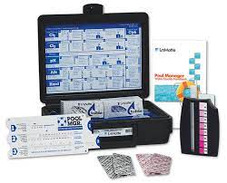
Pool Operation
Competent person in charge.
Chemical testing prior to use each day and often during use. Give yourself correction time.
Safety plan complete.
Call with problems / need for assistance.
Operation reports kept up to date.
Daily inspections.
Notes:
Make sure you have responsible people maintaining the pools, and ensure whoever is maintaining the pool talks to the people supervising the pool.
If you are starting your first swim session at 1 you may want to check the chemicals before noon to give yourself time to make corrections to the chemical feed equipment so you don’t have to cancel your swim periods.
Waterfront directors must be on top of things at the pool, each time it is used there must be an inspection of the facility to ensure things are ready to go. Your staff needs to know criteria for opening the facility and if that criteria is not met then the pool does not open.
This goes for beach facilities also.

Slide 26
Pool Staff Operation
Current Certifications listed on DOH 367a Must have PSI / WSI to assess swimming ability listed on 367a.
Aquatics Director - Minimum Age requirement (21) / Certifications listed on 367a. Must have successfully completed a training course in lifeguard supervision and management.
Lifeguards - Certifications and CPR up to date.
Notes:
Qualifications and minimum ages for lifeguards
if you do not have all of your staff hired prior to submitting your paperwork than please update and fax or email in prior to camp

Slide 27

Lifeguards
No Distractions (cell phones, other staff, etc.)
Blind spots / Glare.
Other Duties.
Frequent in-services / training.
No voluntary hyperventilating / extended breath holding.

Slide 28

Swimming Buddy System
Detailed procedure in Safety Plan.
Ratios for counselors still need to be maintained at waterfront (in addition to lifeguards).
Non–swimmer/swimmer identification, must be in Safety Plan.
Tag in Tag out, who runs board.
Buddy checks every 15 min or less.
These checks should not take long, quick buddy counts. Get
staff to work together.
Keep Buddies together in pool or on deck.
Notes:
Swimming time is not break time for the staff supervising the campers, counselors ratios must be maintained during swimming, in addition to required lifeguards.
Make sure your counselor staff is familiar with the buddy system and use them to implement the system.
Also make sure your campers are aware of their responsibilities in the system, get them to buy in to the process. I.e., the quicker we are able to do the check the quicker you are able to get back to swimming
Please observe your procedures from time to time to see that it works. I don’t want the first time you observe a buddy check to be when I am there.

Slide 29

Off Camp Trips
Must be covered in Safety Plan.
Review Plan 24 hrs. in advance of trip.
Supervision (Trip leader at least 18 yrs old)
Trip leader First Aid Training.
Swimming off site?
Trip Safety plan as well as trip swimming safety plan templates available.
Notes:
We need all trips outlined in safety plans and you are to review the plan with your trip leader 24 hours before the trip to make sure everyone is on the same page.
Make sure you have communication between camp and the trip and or at a minimum some sort of communication capabilities from the trip to EMS if needed.

Slide 30

Food Service
Food from approved sources.
Proper cooking, cooling, and hot holding temperatures.
Accurate cook thermometers.
Proper glove use.
Ill food worker policy.
Cross contamination.
Unprotected buffet/table vs cafeteria style.
Notes:
Be sure of cook temps
and be sure you are excluding ill people from the kitchen. Hand washing.
Food served (put on buffet or table is to be tossed after meal) if food remains behind counter (cafeteria style may be kept if properly hot held and then cooled after the meal)
Salad bar material must be tossed if not protected during service (sneeze guards)
Rotate your stock on service line please no never ending salad and toppings.

Slide 31

Dates to Remember
Please submit application and all other forms sixty days prior to camp.
Pre-operational Inspection before camp starts.
Water Samples 15 days minimum prior to opening.
Notes:
Just a reminder 60 days not 60 min. There is good reason for the time deadlines and we will no longer permit a camp when the paperwork is not submitted in a timely fashion, especially for camps that are chronically late with information.

Slide 32
For Additional Information Visit NYSDOH Website at:
https://www.health.ny.gov/environmental/outdoors/camps/operators.htm
Or
The Wyoming County Health Department
Camp website at:
http://www.wyomingco.net/237/Childrens-Camps

Slide 33
Thank you for taking part in the children’s camp meeting for 2025.
Enjoy the summer season!

